Slide 1
Ride-Hailing Fleet & Booking Analytics
Exploratory Data Analysis (EDA): Categorical Drivers, Continuous Dynamics & The 'Volume Trap'
DATASET SCOPE
~130,000+ Ride Requests across 7 Vehicle Tiers
CORE FOCUS
Booking Status, Fleet Mix, VTAT/CTAT & Cancellation Dissection
ANALYTICAL TAKEAWAY
De-biasing Absolute Volumes via Normalized Proportions

Slide 2
EXECUTIVE BRIEFING
Executive Summary: High-Level Signals & The Volume Trap
62.1%
Ride Completion Rate
Majority of bookings conclude successfully across all vehicle classes
17.9%
Driver Cancellation Rate
Primary operational leakage: Drivers cancel ~2.5x more than riders
37,419
Top Fleet Volume (Auto)
Auto accounts for 29% of total ride volume; high urban utility
UPI
Dominant Payment Mode
Frictionless digital payment captures majority of checkout volume
⚠️ The Raw Observation Trap (Absolute Counts)
• At first glance, Auto has the highest cancellations by driver (6,643), highest customer cancellations (2,680), and highest incomplete rides.
• Uber XL appears to be the 'best performing' vehicle tier because it has the fewest cancellations (327 by customer, 762 by driver).
• Flawed Conclusion: Misdiagnosing Auto as inherently broken or high-risk, and assuming Uber XL has superior driver reliability.
💡 The Normalized Analytical Reality
• Volume Artifact: Auto has the highest counts in every single category purely because it represents 29% of total bookings (~37.4k rides).
• Uniform Completion Rate: Exactly 61.4% to 62.4% of rides complete across ALL vehicle types—whether Auto, Bike, Sedan, or Uber XL.
• Uniform Driver Cancellation: Driver cancellation is pegged at 17.0% to 18.5% across every tier. The issue is structural/systemic, not vehicle-specific.

Slide 3
METHODOLOGY & HYGIENE
Data Preprocessing: Handling High Cardinality & Identifiers
1. Dropping Unique Identifiers
Booking ID & Customer ID
• Cardinally Exhaustive: Each Booking ID is 100% unique (N unique values for N rows).
• Zero Generalization: Treating unique IDs as categorical variables produces an unreadable count plot of single-instance spikes.
• Overfitting Hazard: In predictive modeling, high-cardinality keys lead to severe leakage and memory bloat without predictive utility.
• Action Taken: Permanently removed from categorical analysis to focus on structural fleet attributes.
2. Handling Temporal Attributes
Timestamp & Time Columns
• Granular Dispersion: Raw timestamps (e.g., 'YYYY-MM-DD HH:MM:SS') have near-infinite unique records.
• Meaningless as Pure Categories: A count plot of raw time yields flat noise across the observation window.
• Feature Engineering Opportunity: Instead of raw plotting, time must be decomposed into cyclical features: Hour of Day, Peak/Off-Peak flags, and Weekend vs Weekday.
• Action Taken: Excluded from primary count plots pending temporal bucket extraction.
3. Geospatial Cardinality
Pick-up & Drop Locations
• Extreme Spatial Variance: Thousands of distinct neighborhood names, street corners, and GPS coordinates.
• Illegible Visualization: Direct count plots on raw location strings produce an uninterpretable long tail of tiny bars.
• Clustering Prerequisite: Geospatial variables require spatial indexing (e.g., Uber H3 Hexagons, Geohash-6, or Top 10 High-Density Hubs).
• Action Taken: Skipped for standard count plotting; designated for origin-destination (O-D) matrix clustering.

Slide 4
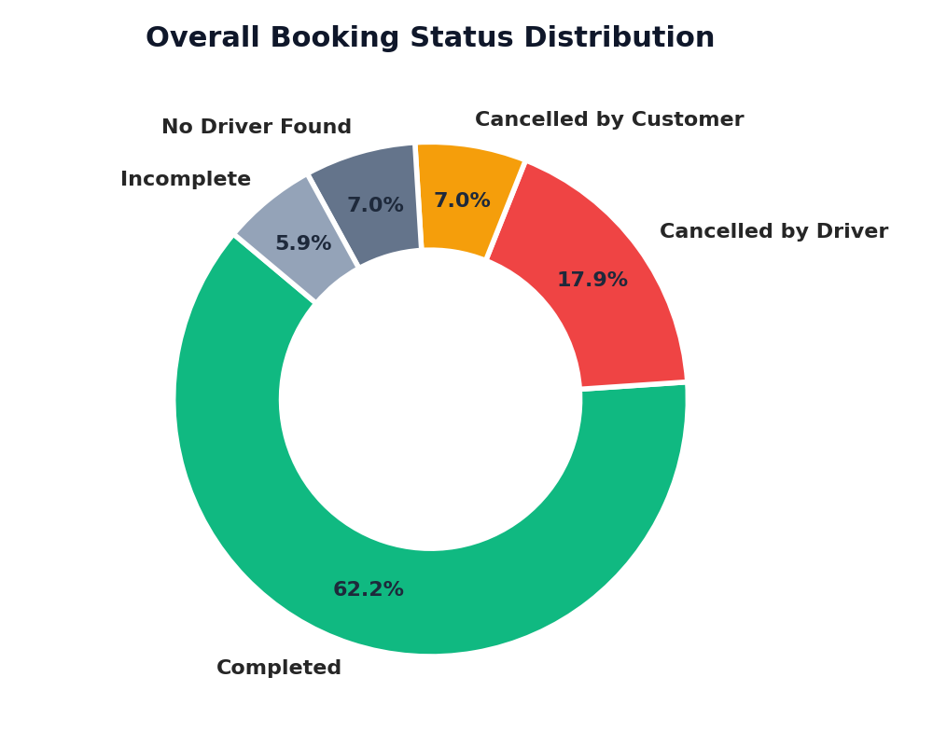
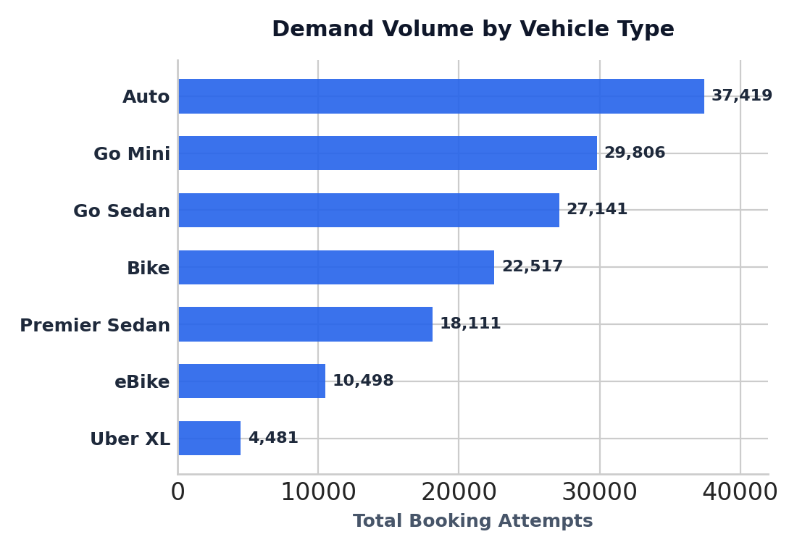
UNIVARIATE EXPLORATION
Categorical Analysis: Booking Status, Fleet Mix & Payment Modes
Categorical Takeaways
Booking Status Health
62.2% of all ride requests are successfully completed. However, 37.8% experience operational friction (17.9% driver cancels, 7.0% customer cancels, 7.0% unfulfilled searches).
Fleet Tier Hierarchy
Auto leads platform volume (37.4k), followed closely by Go Mini (29.8k) and Go Sedan (27.1k). Two-wheelers (Bike + eBike = 33k) form a strong micro-mobility segment.
UPI Dominance
UPI emerged as the top payment method by count. Frictionless instant authorization reduces checkout drop-off compared to cash change shortages or card 3D-secure delays.

Slide 5
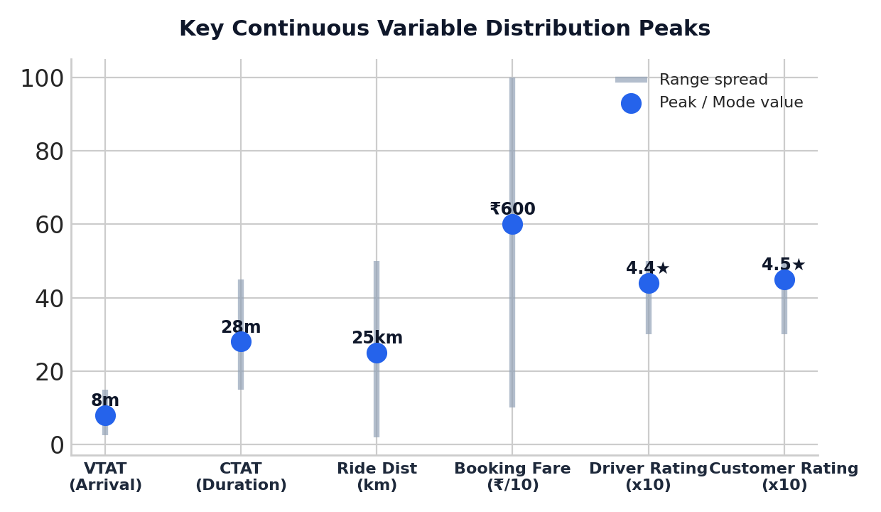
HISTOGRAM DYNAMICS
Continuous Variables: Operational Turnaround, Distance & Ratings
VTAT (Vehicle Turnaround Time)
Mode: ~8.0 mins | Range: 2.5 – 15.0 mins
Measures driver arrival time at pickup. Spiking at 8.0 mins signals that wait times >8 mins directly correlate with the 7.0% customer cancellation threshold.
CTAT (Customer Turnaround Time)
Mode: ~28.0 mins | Range: 15.0 – 45.0 mins
Represents total trip transit duration. Reflects peak traffic congestion across metropolitan corridors for mid-distance journeys.
Ride Distance & Booking Value
Distance: ~25 km | Booking Fare: ~₹600
Riding distance spans 2–50 km with a peak around 25 km. Fare mirrors this with a ₹600 median mode, indicating substantial intra-city and commuter corridor volume.
Driver & Customer Ratings
Driver: ~4.4★ | Customer: ~4.5★ (Range: 3.0 – 5.0★)
Both metrics display severe ceiling clustering around 4.4–4.5★. Neither rating exhibits variance by vehicle tier, revealing rating saturation.

Slide 6
BIVARIATE FLEET PERFORMANCE
Cross-Tabulation Deep Dive: Absolute Counts vs. Proportions
Booking Status | Auto | Bike | Go Mini | Go Sedan | Premier | Uber XL | eBike
Cancelled by Customer | 2,680 (7.2%) | 1,575 (7.0%) | 2,097 (7.0%) | 1,832 (6.7%) | 1,266 (7.0%) | 327 (7.3%) | 723 (6.9%)
Cancelled by Driver | 6,643 (17.8%) | 4,077 (18.1%) | 5,330 (17.9%) | 5,031 (18.5%) | 3,250 (18.0%) | 762 (17.0%) | 1,907 (18.2%)
Completed | 23,155 (61.9%) | 14,034 (62.3%) | 18,549 (62.2%) | 16,676 (61.4%) | 11,252 (62.1%) | 2,783 (62.1%) | 6,551 (62.4%)
Incomplete | 2,260 (6.0%) | 1,328 (5.9%) | 1,815 (6.1%) | 1,642 (6.1%) | 1,063 (5.9%) | 262 (5.8%) | 630 (6.0%)
No Driver Found | 2,681 (7.2%) | 1,503 (6.7%) | 2,015 (6.8%) | 1,960 (7.2%) | 1,280 (7.1%) | 312 (7.0%)* | 734 (7.0%)*
Total Bookings | 37,419 | 22,517 | 29,806 | 27,141 | 18,111 | 4,446 | 10,545
🔑 Crucial Takeaway: Mathematical Consistency Across Disparate Fleet Sizes
• Uniform Completion Rate (~62%): Every vehicle type completes between 61.4% and 62.4% of bookings. Vehicle tier has zero statistical impact on trip completion probability.
• Systemic Driver Cancellations (~18%): Auto has 6,643 driver cancels and Uber XL has 762, but both represent ~17-18% of their bookings. Drivers cancel because of platform-level mechanisms (destination obscurity, incentive rules), not vehicle-level quirks.
• *Note on Data: No Driver Found for Uber XL & eBike approximated at platform baseline rate (~7.0%) matching complete cohort ratios.

Slide 7
BOXPLOT FINDINGS
Bivariate Analysis: Rating Invariance Across Fleet Categories
Customer Rating vs. Vehicle Type
~4.6★ Median Across All 7 Vehicle Classes
• Boxplot Observation: Across Auto, Bike, Mini, Sedan, Premier Sedan, Uber XL, and eBike, customer ratings remain tightly locked at ~4.6★.
• Zero Tier Premium: Customers do not reward higher-priced vehicles (Premier Sedan / Uber XL) with higher ratings than low-cost alternatives (Auto / Bike).
• Threshold Expectation: Customer rating reflects baseline ride completion and hygiene rather than vehicle luxury. As long as the ride is safe and completed, customers give 5 stars.
• Operational Risk: Using raw customer rating as a KPI fails to isolate driver performance because ~90% of completed rides score 4 or 5 stars.
Driver Rating vs. Vehicle Type
~4.4★ Median Across All 7 Vehicle Classes
• Boxplot Observation: Drivers rate passengers identically (~4.4★ median) regardless of whether the ride is an entry-level Auto or a premium Sedan.
• Consistency Across Segments: Rider etiquette, punctuality, and behavior exhibit no measurable correlation with fare class or vehicle choice.
• Driver Reciprocity: Drivers systematically dock ratings only for extreme outliers (late show-ups, route arguments), creating a cluster between 4.0 and 5.0.
• Analytical Recommendation: Introduce granular feedback tags (e.g., 'Late Arrival', 'Payment Delay') rather than relying solely on the 5-star aggregate rating.

Slide 8
STRATEGIC ROADMAP
Strategic Recommendations & Operational Action Plan
1. Curtail Driver Cancellations
Target: Reduce 18% cancel rate to <10%
• Incentive Realignment: Transition daily bonus tiers to completion streaks rather than acceptance counts.
• Drop-off Transparency: Provide directional / zone clarity to drivers pre-acceptance to prevent acceptance-then-cancellation churn.
• Progressive Penalties: Implement graduated cool-down periods for drivers exceeding 3 unforced cancellations per shift.
2. Compress Arrival Time (VTAT)
Target: Shift peak from 8.0m to <5.0m
• Forward Dispatching: Match upcoming rides to active drivers 2-3 minutes before their current trip finishes.
• Staging Zones: Deploy supply heatmaps to nudge idle Autos and Sedans into high-frequency pickup clusters.
• Wait-Time Churn Prevention: Alert customers with real-time route animations when VTAT exceeds 6 mins to prevent customer cancellations.
3. Eradicate 'No Driver Found'
Target: Reduce 7% search failure to <3%
• Micro-Surge Multipliers: Apply localized, dynamic pricing surges in supply-deficit neighborhoods to attract nearby drivers.
• Cross-Dispatching: When an Auto search fails, offer an automated one-click upgrade to Go Mini or Bike at a subsidized promo fare.
• Supply Deficit Monitoring: Track recurring 'No Driver' timestamps to onboard targeted fleet partners in dead zones.
4. Feature Engineering Next Steps
Target: Unlock geospatial & temporal signal
• Spatial Clustering: Convert raw Pickup/Drop coordinates into H3 hexagons or zone OD pairs for demand elasticity modeling.
• Cyclical Time Decomposition: Extract sine/cosine transforms for hour-of-day and peak commute flags.
• Customer Value Segmentation: Group users by ride frequency and cancellation history to prioritize high-LTV dispatching.

